Slide 1
Coastal Threat Alert System
Team Name:- Clt Alt Win
Team Members:- Riya Dave(Leader)
Prachi Mehta
Jinal Vasita
Karishma Tilva

Slide 2
Problem Statement
Coastal regions are increasingly exposed to storm surges, sea-level rise, erosion, and pollution, which threaten human lives, ecosystems, and economies.
Currently, there is a lack of integrated early warning systems that can analyze real-time data, detect anomalies, and deliver timely alerts to authorities and communities.
This gap leads to delayed interventions, higher disaster impact, and avoidable damage to both people and coastal habitats

Slide 3
Objective
To build an AI-driven Coastal Threat Alert System that predicts tide and flood risks, integrates multiple data sources, and provides real-time alerts and dashboards to help authorities and communities take timely action

Slide 4
Users & Impact
Users
Disaster Management Departments
Coastal City Governments
Fisherfolk & Coastal Communities
Environmental NGOs & Civil Defence Teams
Impact
Saves lives through timely alerts and interventions
Reduces economic losses from coastal disasters
Preserves blue carbon habitats and ecosystems
Builds resilience in vulnerable coastal communities

Slide 5
Tech Stack

Slide 6
Data & Processing Tide Prediction Dataset
Coastal Climate & Risk Dataset
Python (Pandas, NumPy, Scikit-learn)
AI / ML Models
Random Forest Classifier → Flood Risk Prediction
Random Forest Regressor → Tide Level Prediction
Joblib → Model Saving & Deployment
Frontend & Visualization
Streamlit → Interactive Dashboard
Folium → Map-based Input & Display
Future Integrations
IoT Sensors & Satellite Feeds
SMS / Push Notification APIs

Slide 7
Methodology

Slide 8
Data Collection
Gathered datasets on tide predictions and coastal climate risk factors
Data Preprocessing
Cleaned, merged, and prepared datasets for training.
Model Development
Trained Random Forest Regressor for tide prediction
Model Deployment
Trained Random Forest Classifier for flood/coastal risk prediction
Dashboard & Visualization
Saved models using Joblib for integration
Built an interactive Streamlit dashboard
Integrated map-based input (Folium) for location-specific risk analysis

Slide 9
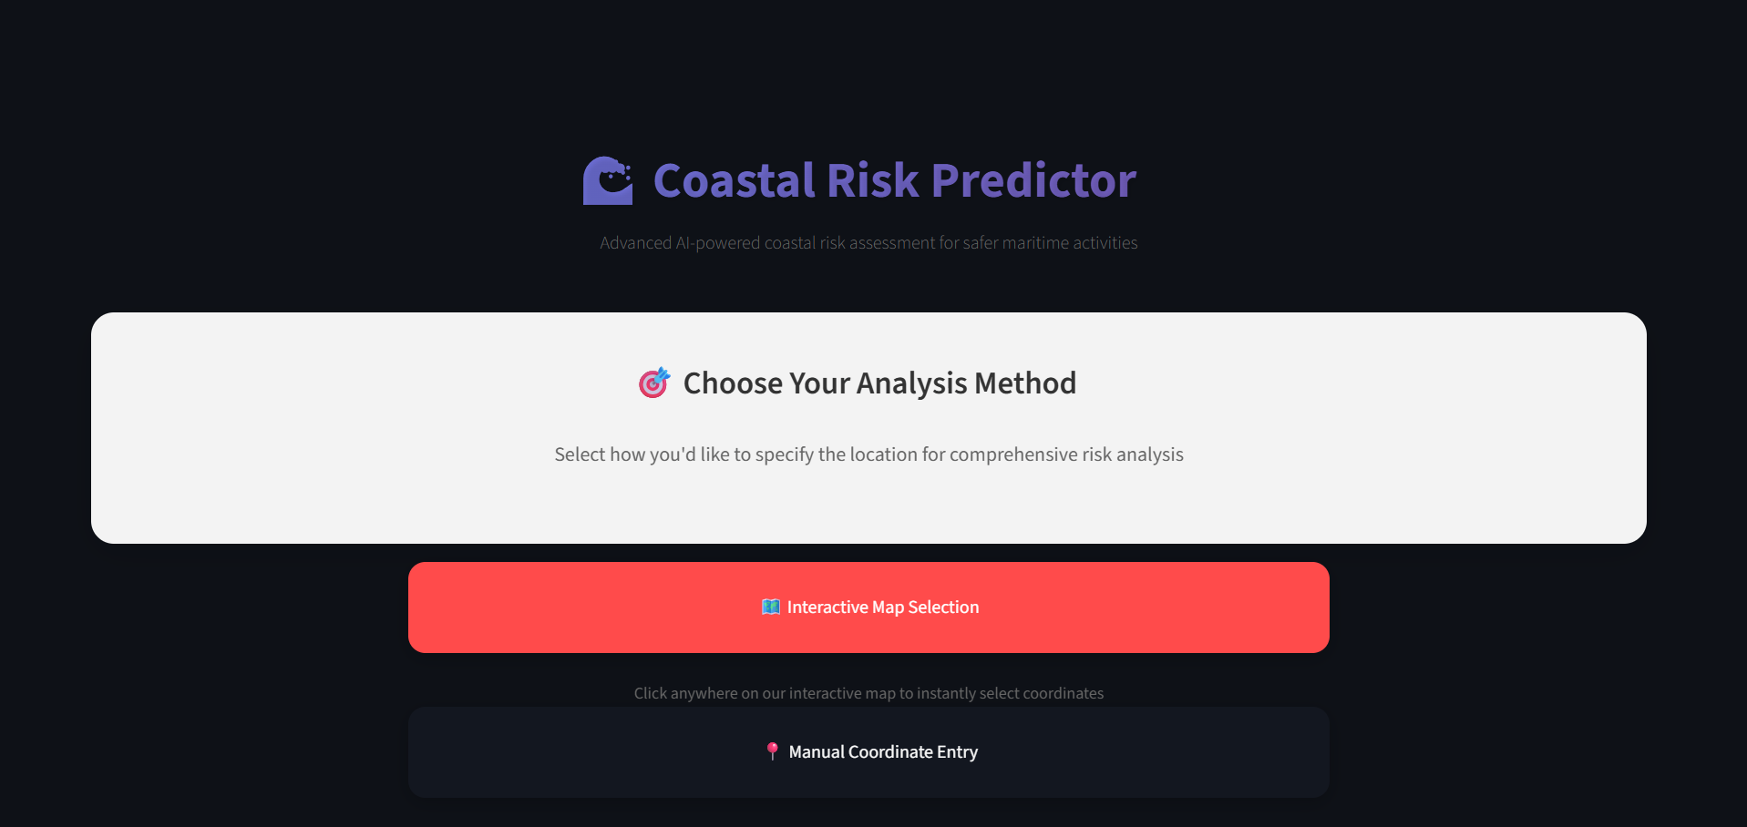
Demo

Slide 10
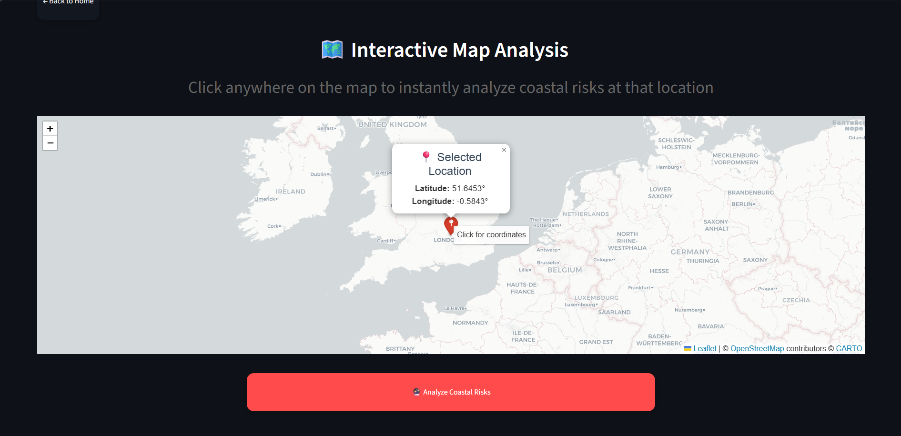

Slide 11
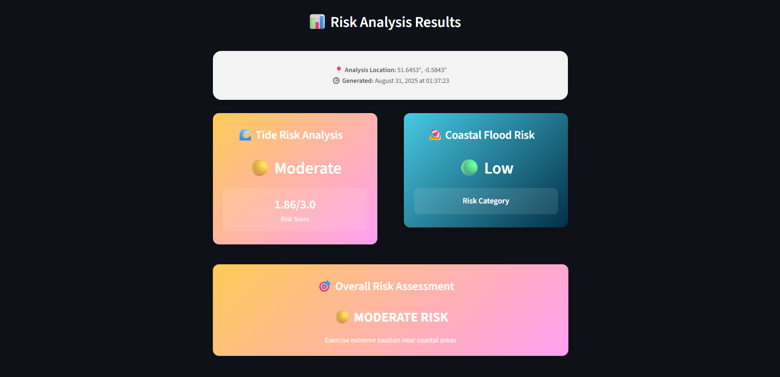

Slide 12
Innovation
Dual-Model AI System – Separate ML models for tide prediction and flood risk assessment.
Geospatial Intelligence – Map-based inputs allow location-specific risk detection.
Early Warning Capability – Translates data insights into timely, actionable alerts.
Scalable Design – Can integrate future IoT sensors, satellite feeds, and real-time pipelines.
Holistic Impact – Protects lives, ecosystems, and livelihoods with a single unified platform.

Slide 13
Future Work
Integration of IoT & Satellite Feeds – Real-time data from tide gauges, weather stations, and satellites.
Automated Alert System – SMS / push notifications for communities and authorities.
Advanced AI Models – Deep learning for improved prediction accuracy and anomaly detection.
Enhanced GIS Mapping – High-resolution geospatial visualization of risk zones.
Collaboration with Authorities – Deployment with disaster management teams and NGOs.
Mobile Application – User-friendly app for fishermen and coastal residents.

Slide 14
Conclusion
Developed an AI-powered Coastal Threat Alert System integrating tide and risk prediction models.
Built an interactive dashboard with map-based inputs for location-specific analysis.
Demonstrated how technology can save lives, protect ecosystems, and support disaster management.
Provides a scalable foundation for real-time alerts and future integrations with IoT & mobile apps.

Slide 15
THANK YOU

